Slide 1
Introduction
Management:Concepts,meaning &fuctions.

Slide 2
Management Concept &Meaning
Management is the coordination and administration of tasks to a achieve a goal.
In other words, it is a process of various functions like planning, organizing, leading, and controlling the business operations in such a manner as to achieve the objectives set by the business firm.
Mary Parker Follet defines management as, “The art of getting things done through people”

Slide 3
Importance of Management
1) Helps to achieve goals and objectives.
2) Provides a sense of focus and direction.
3) For optimum utilization of resources.
4) To maintain responsibility and order.
5) To get the most qualified personnel for the job.
6) To reduce workload and get things done.
7) Helps facilitate good communication.

Slide 4
Functions of management
Planning,
Organizing,
Staffing,
Directing,
Controlling,
Co-Ordination
Co-Operation
and Motivating

Slide 5
Types of Manager
Top level Manager
Chief ,CEO (chief executive officer),GM(general manager)
These managers help sustain the company’s growth and execute plans over the long term.
They make major business decision such as launching a new product or restructuring departments.
Facilitating strategic partnerships with other companies or deciding to take a company public.

Slide 6
Middle level Manager
Directors, department head.
Contact between first line managers and top level manager.
May help develop or implement plans to help top level manager address obstacles or achieve certain business goals.
Mentoring lower level managers and helping them prepare for career advancement.

Slide 7
First line Manager
Branch Manager
First line managers work directly with non management employees and project team members.
Generally, first line manager handle internal work only.
In other words, they are not responsible for larger scale business decisions, like whether to take company public, Rebrand, partner with another company.

Slide 8
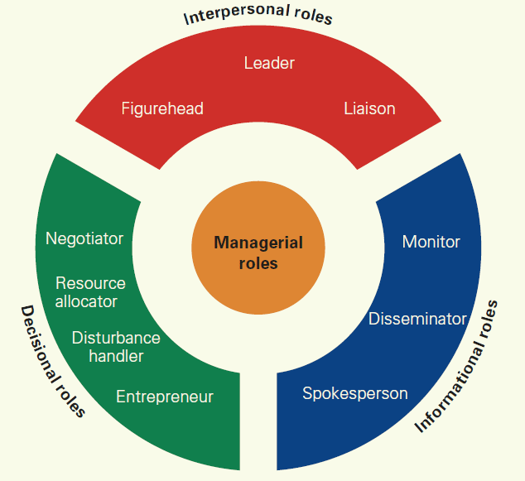
Managerial roles and skills

Slide 9
Roles….
Figure head Role
The entrepreneur needs to be the Head in the organization and participate in ceremonial(informal) duties, such as representing the organization in formal and informal events or even being the public spokesperson whenever there is a press release, etc.
Leader Role
The entrepreneur should also act as a leader because an entrepreneur may need to bring people with dissenting views and approaches to work together as a team. So, he needs to be good with his people management and leadership skills. He has to lead the people by hiring, firing, training and motivating his resources as and when necessary.

Slide 10
liaison(communicate) Role
The entrepreneur should also be the liaison officer for his organization. He should be the source of link with the outside world and business houses, always trying to find an opportunity of working together with other big organizations.
Monitor Role
The entrepreneur acts as a regulatory body too; he monitors both the internal and the external environment of the business constantly..

Slide 11
Disseminator Role(Information Provider and Receiver Role)
(spread)-something especially information
This is where you communicate potentially useful information to your coworkers and your team.
Spokesperson Role
Managers represent and speak for their organization. In this role, you're responsible for communicating information about your organization and its goals to the people outside it.

Slide 12
Negotiator Role
A Negotiator is primarily in charge of communicating with clients and business partners to negotiate and establish sales, building positive relationships in the process.
Resource allocator Role
The entrepreneur needs to find out how the available resources can be allocated between different departments of the organization to suit their demands and necessities. This helps them achieve the organizational goals and the objectives.

Slide 13
Disturbance handler Role
The entrepreneur needs to act as the mediator and bring people with dissenting(असहमति) thoughts to the table and get them motivated to work together. He needs to handle all conflicts and get the team to focus constantly on the goal.
Entrepreneur Role
This is the basic role of the entrepreneur; he/she declares new ideas for the organizations, brainstorms it with the employees and friends and then bears the risk of any unsuccessful implementation.

Slide 14
Three Types of Managerial Skills
Robert Katz identifies three types of skills that are essential for a successful management process:
1.Technical skills,
2.Conceptual skills and
3.Human or interpersonal management skills.

Slide 15
1.Technical skills
Technical skills are not related only for machines, production tools or other equipment, but also they are skills that will be required to increase sales, design different types of products and services, market the products and services, etc.
Technical skills are most important for first-level managers. When it comes to the top managers, these skills are not something with high significance level. As we go through a hierarchy from the bottom to higher levels, the technical skills lose their importance.

Slide 16
2. Conceptual skills
Conceptual skills present knowledge or ability of a manager for more abstract thinking. That means he can easily see the whole through analysis and diagnosis of different states. In such a way they can predict the future of the business or department as a whole.
Conceptual skills are vital for top managers, less critical for mid-level managers and not required for first-level managers. As we go from the bottom of the managerial hierarchy to the top, the importance of these skills will rise.

Slide 17
3.Human or interpersonal management skills.
Human or interpersonal management skills present a manager’s knowledge and ability to work with people. One of the most critical management tasks is to work with people. Without people, there will not be a need for the existence of management and managers.
These skills enable managers to become leaders and motivate employees for better accomplishments. Additionally, they help them to make more effective use of human potential in the company. Simply, they are essential skills for all hierarchical levels in the company.

Slide 18
Exercise
i) Define and explain the concept of management.
ii) Explain the features of management.
iii) Discuss in detail the functions of management
iv) Explain the importance of management for an organization.
v)Who is called a manager? What skills does he need to be successful?
vi)Explain the role of a manager.
vii) What functions do managers perform?

Slide 19
Features of management
i) Management is Goal-Oriented:
ii) Management integrates Human, Physical and Financial Resources:
iii) Management is Continuous:
iv) Management is all Pervasive(broadly):
v) Management is a Group Activity:

Slide 20
Organization
Definition: Organization refers to a collection of people, who are involved in pursuing defined objectives. It can be understood as a social system which comprises all formal human relationships. The organization encompasses division of work among employees and alignment of tasks towards the ultimate goal of the company.
It can also be referred as the second most important managerial function, that coordinates the work of employees, procures resources and combines the two, in pursuance(observation) of company’s goals.

Slide 21
What is a manager?
A manager is a person who is responsible for a part of a company, i.e., they ‘manage‘ the company. Managers may be in charge of a department and the people who work in it. In some cases, the manager is in charge of the whole business. For example, a ‘restaurant manager’ is in charge of the whole restaurant.
A manager is a person who exercises managerial functions primarily. They should have the power to hire, fire, discipline, do performance appraisals, and monitor attendance. They should also have the power to approve overtime, and authorize vacations

